Slide 1

Big Data Storage Concepts

Slide 2
Clusters
In computing, a cluster is a tightly coupled collection of servers, or nodes. These servers. usually have the same hardware specifications and are connected together via a network to work as a single unit

Slide 3
File Systems and Distributed File Systems
A file system is the method of storing and organizing data on a storage device, such as flash drives, DVDs and hard drives.
A file is an atomic unit of storage used by the file system to store data.
A file system provides a logical view of the data stored on the storage device and presents it as a tree structure of directories and files as pictured in Figure 5.2

Slide 6
NoSQL
A Not-only SQL (NoSQL) database is a non-relational database that is highly scalable,fault-tolerant and specifically designed to house semi-structured and unstructured data. A NoSQL database often provides an API-based query interface that can be called from within an application

Slide 8
Sharding
Sharding is the process of horizontally partitioning a large dataset into a collection of smaller, more manageable datasets called shards. The shards are distributed across multiple nodes, where a node is a server or a machine.

Slide 10
Figure 5.6 presents an illustration of how sharding works in practice:
1. Each shard can independently service reads and writes for the specific subset of data that it is responsible for.
2. Depending on the query, data may need to be fetched from both shards.

Slide 12
Replication
Replication stores multiple copies of a dataset, known as replicas, on multiple nodes. (Figure 5.7).

Slide 13
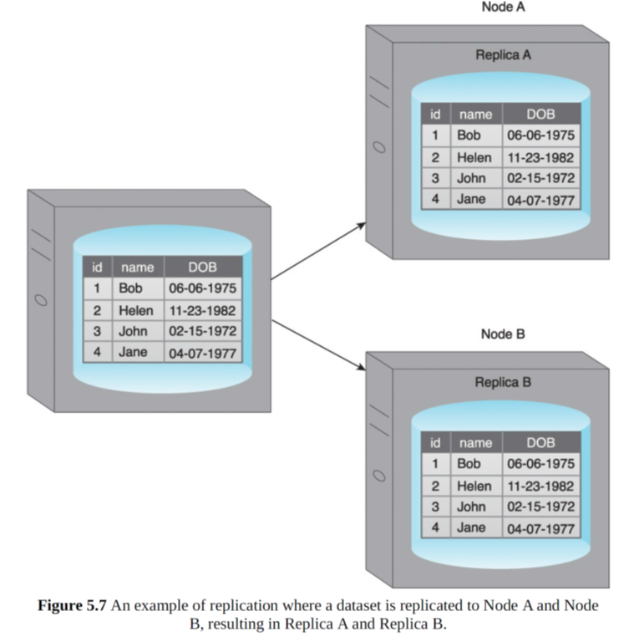

Slide 14
Master-Slave
During master-slave replication, nodes are arranged in a master-slave configuration, and all data is written to a master node. Once saved, the data is replicated over to multiple slave nodes. All external write requests, including insert, update and delete, occur on the master node, whereas read requests can be fulfilled by any slave node. In Figure 5.8, writes are managed by the master node and data can be read from either Slave A or Slave B.

Slide 17
Peer-to-Peer
With peer-to-peer replication, all nodes operate at the same level. In other words, there is not a master-slave relationship between the nodes. Each node, known as a peer, is equally capable of handling reads and writes. Each write is copied to all peers, as illustrated in
Figure 5.10.

Slide 19
Figure 5.11 demonstrates a scenario where an inconsistent read occurs.
1. User A updates data.
2. a. The data is copied over to Peer A.
b. The data is copied over to Peer B.
3. Before the data is copied over to Peer C, User B tries to read the data from Peer C, resulting in an inconsistent read.
4. The data will eventually be updated on Peer C, and the database will once again become consistent

Slide 21
Sharding and Replication
To improve on the limited fault tolerance offered by sharding, while additionally benefiting from the increased availability and scalability of replication, both sharding and replication can be combined, as shown in Figure 5.12

Slide 23
Combining Sharding and Master-Slave Replication
When sharding is combined with master-slave replication, multiple shards become slaves of a single master, and the master itself is a shard. Although this results in multiple masters, a single slave-shard can only be managed by a single master-shard.
In Figure 5.13:
• Each node acts both as a master and a slave for different shards.
• Writes (id = 2) to Shard A are regulated by Node A, as it is the master for Shard A.
• Node A replicates data (id = 2) to Node B, which is a slave for Shard A.
• Reads (id = 4) can be served directly by either Node B or Node C as they each contain Shard B.

Slide 25
Combining Sharding and Peer-to-Peer Replication
In Figure 5.14:
• Each node contains replicas of two different shards.
• Writes (id = 3) are replicated to both Node A and Node C (Peers) as they are responsible for Shard C.
• Reads (id = 6) can be served by either Node B or Node C as they each contain Shard B.

Slide 27
CAP Theorem
The Consistency, Availability, and Partition tolerance (CAP) theorem, also known as Brewer’s theorem, expresses a triple constraint related to distributed database systems.
It states that a distributed database system, running on a cluster, can only provide two of the following three properties

Slide 28
Consistency – A read from any node results in the same data across multiple nodes (Figure 5.15).

Slide 29
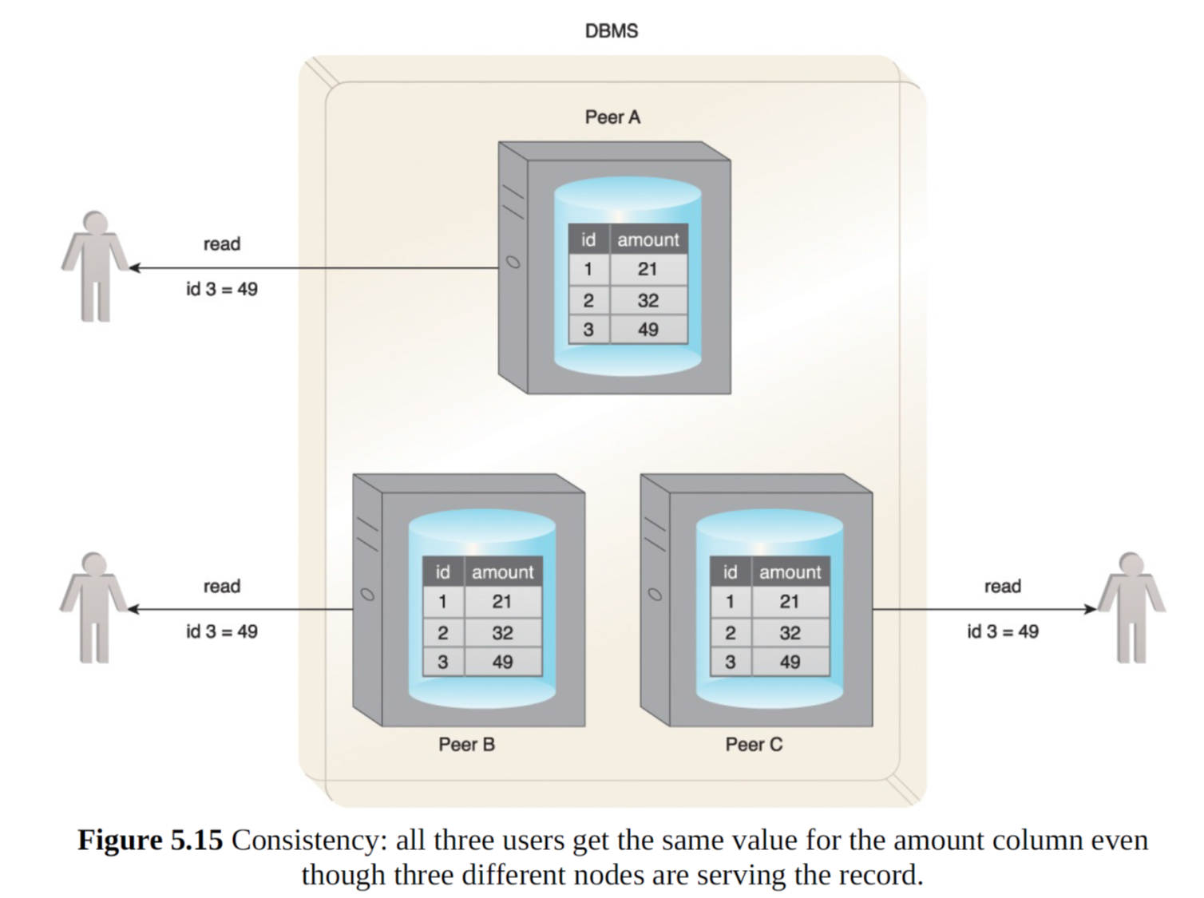

Slide 30
Availability – A read/write request will always be acknowledged in the form of a success or a failure (Figure 5.16).

Slide 31
Partition tolerance – The database system can tolerate communication outages that split the cluster into multiple silos and can still service read/write requests (Figure 5.16).
The following scenarios demonstrate why only two of the three properties of the CAP theorem are simultaneously supportable. To aid this discussion, Figure 5.17 provides a Venn diagram showing the areas of overlap between consistency, availability and partition tolerance.

Slide 33
If consistency (C) and availability (A) are required, available nodes need to communicate
to ensure consistency (C). Therefore, partition tolerance (P) is not possible.
If consistency (C) and partition tolerance (P) are required, nodes cannot remain available
(A) as the nodes will become unavailable while achieving a state of consistency (C).
If availability (A) and partition tolerance (P) are required, then consistency (C) is not
possible because of the data communication requirement between the nodes. So, the
database can remain available (A) but with inconsistent results.
In a distributed database, scalability and fault tolerance can be improved through
additional nodes, although this challenges consistency (C). The addition of nodes can also
cause availability (A) to suffer due to the latency caused by increased communication
between nodes.

